Slide 1



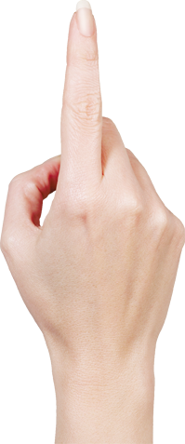
Coding Room
CITI TAX SUITE
Name：Wang, yiwen
SOEID: YW98506

Slide 2
CONTENTS
01
Background
02
Display
03
Design
04
Q&A

Slide 3
PART 01
Background

Slide 4
Background
Background
Why
I always see my teammates do on call interview but no actual coding may we can know more about the candidate with a actual coding environment
Practice some new development framework and review my knowleage I learned in the past one year.
For me

Slide 5
PART 02
Display

Slide 6
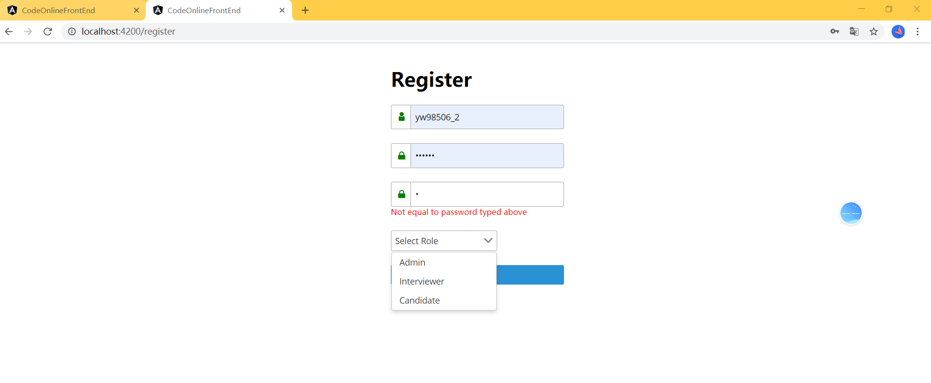
Videos: https://github.com/YiWen-Wang/Coding-Room/tree/dev

Slide 7
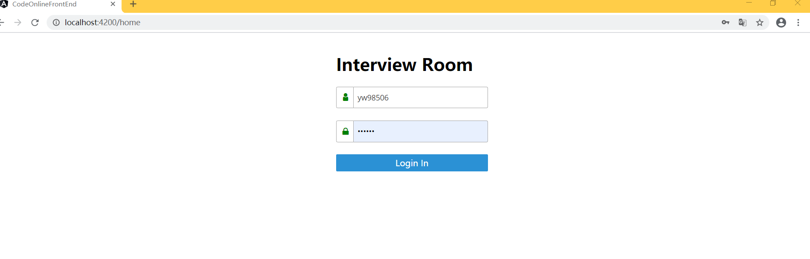
Display

Slide 8
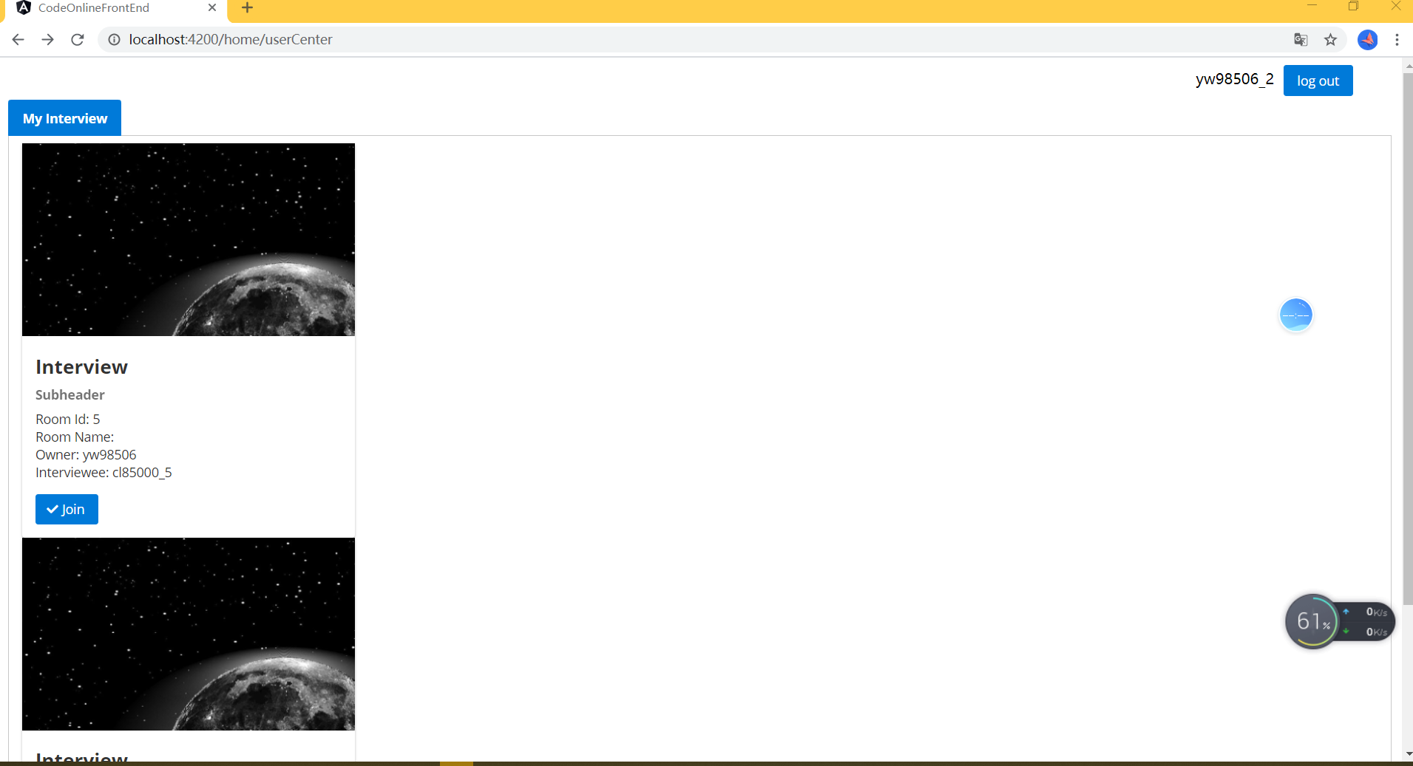

Slide 9
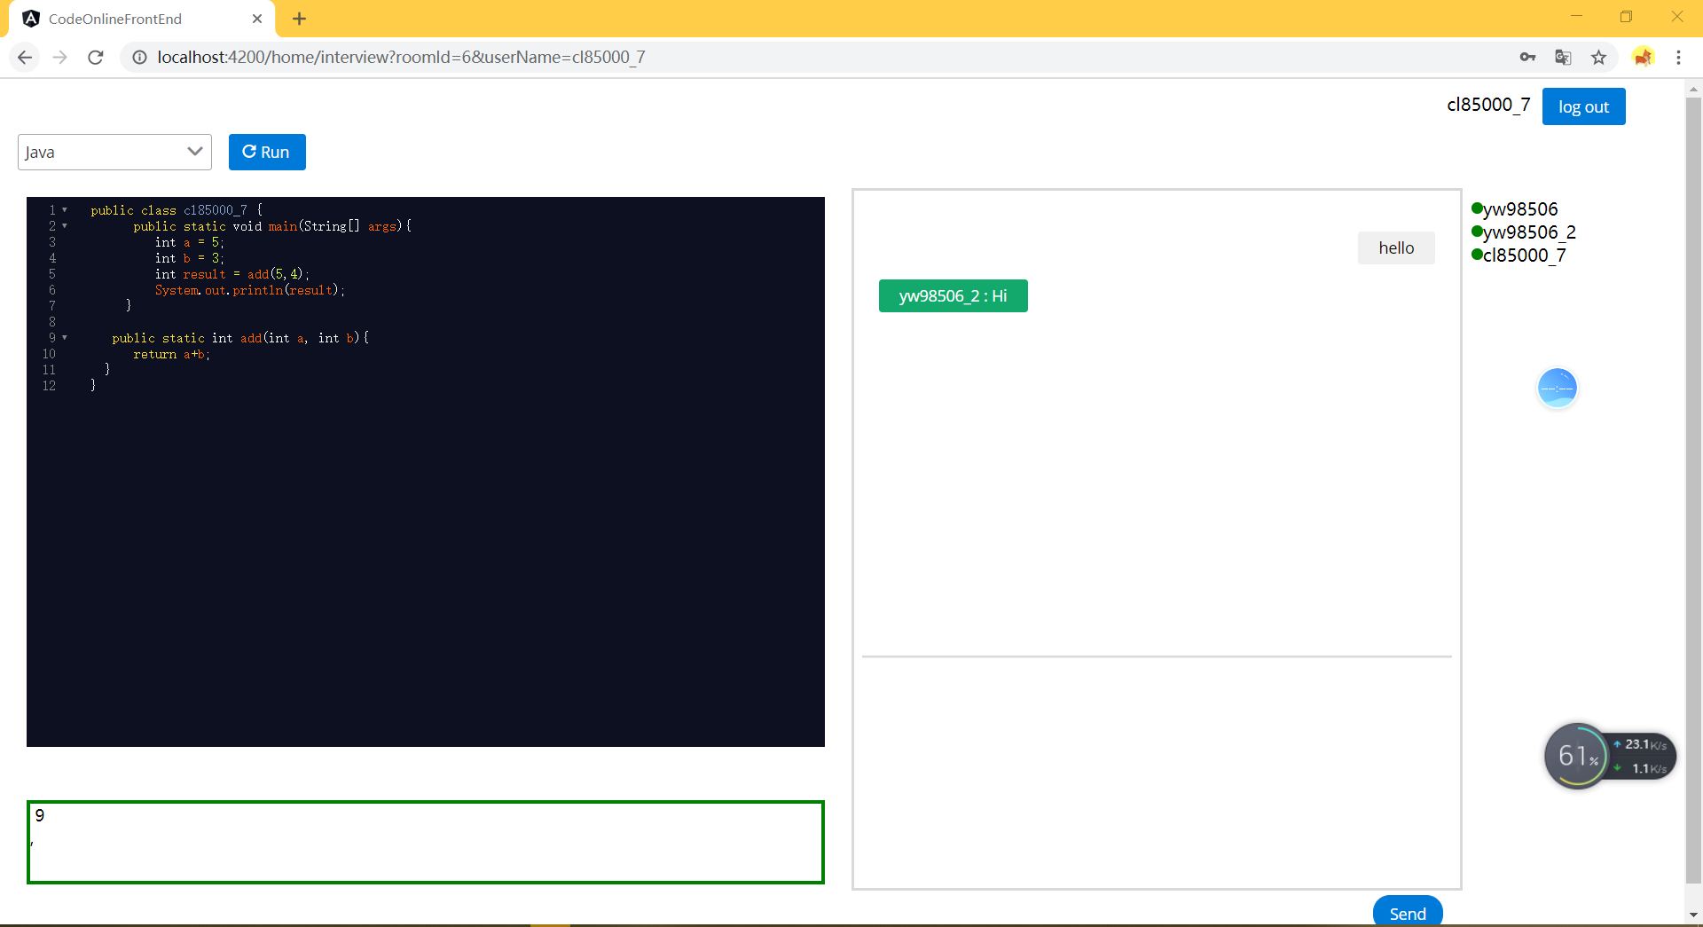

Slide 10
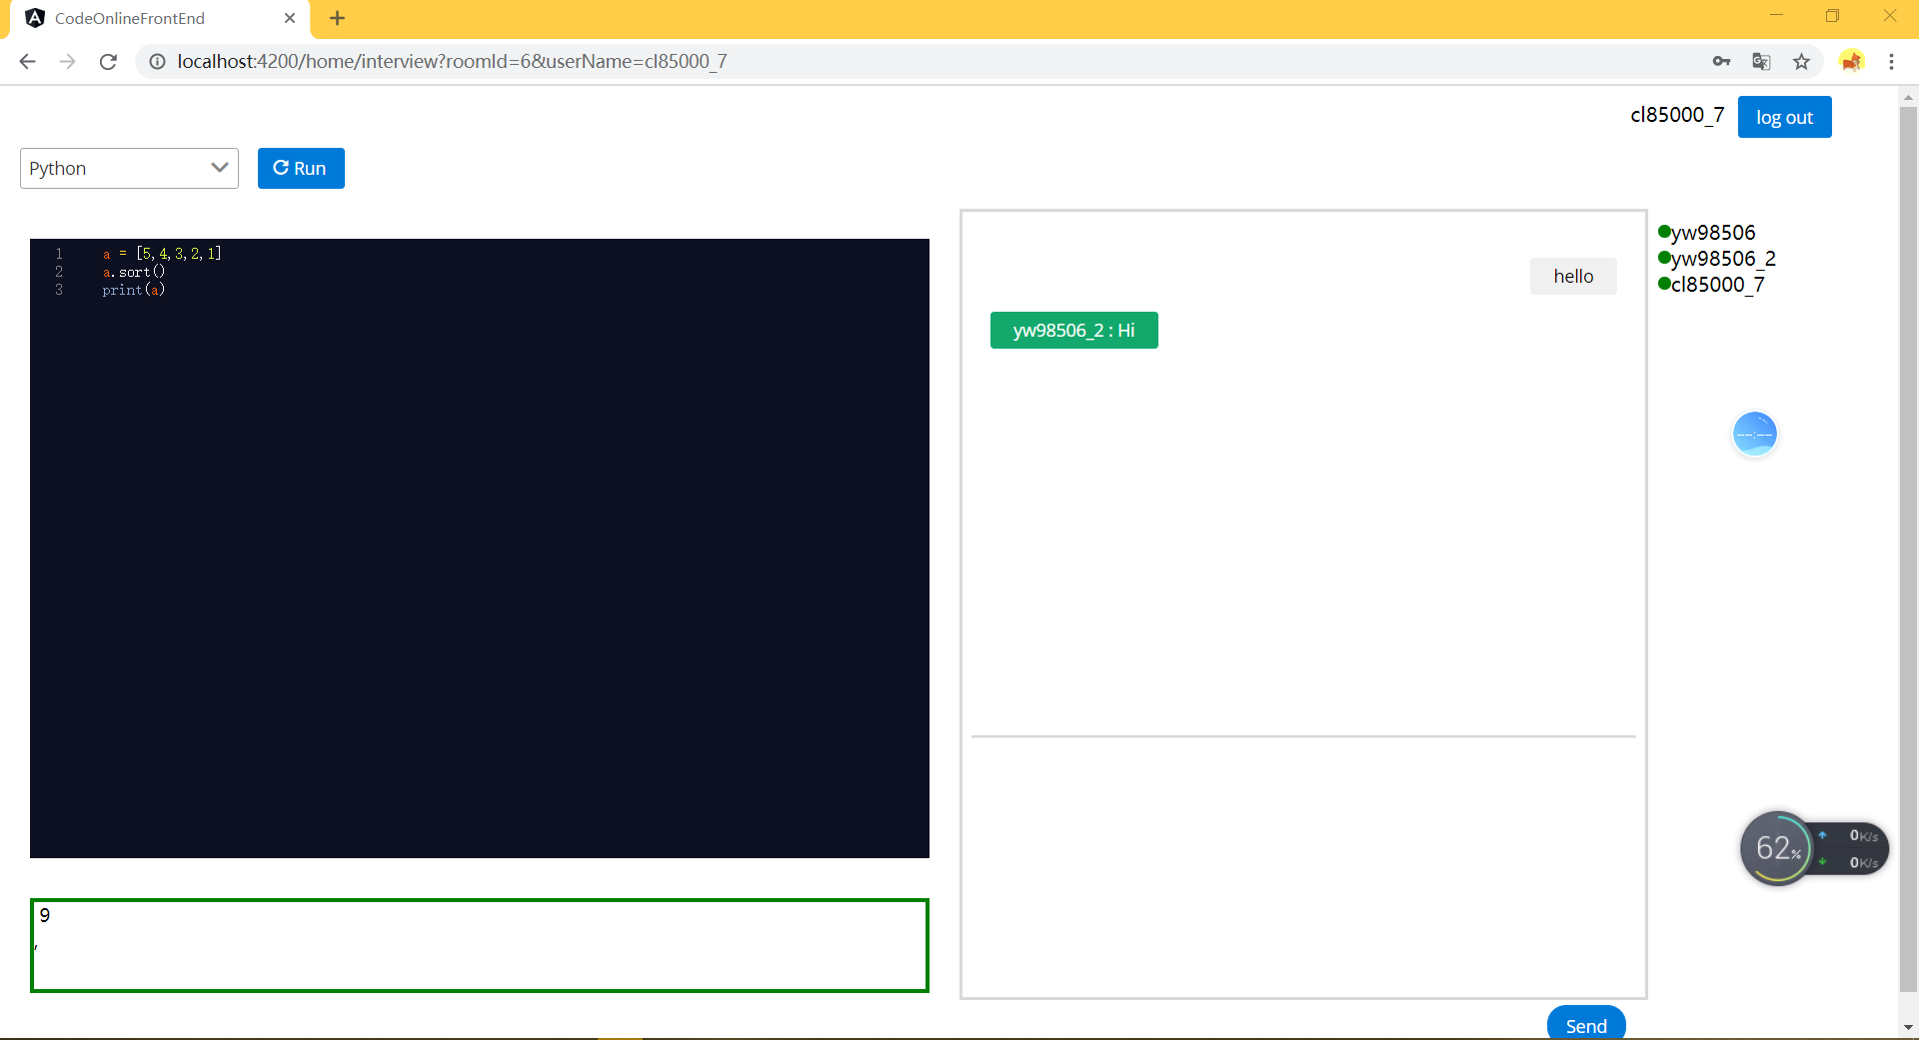

Slide 11
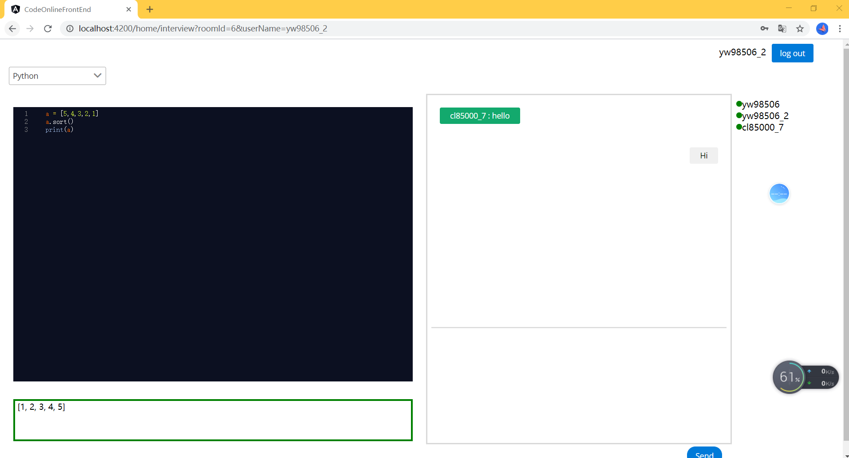

Slide 12
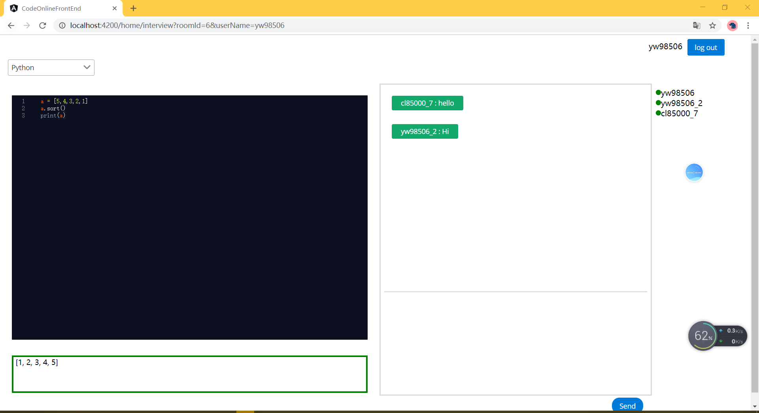

Slide 13
PART 03
Design
code: https://github.com/YiWen-Wang/Coding-Room/tree/dev/AnalystProjectV2

Slide 15
PART 04
Q&A

